Slide 1
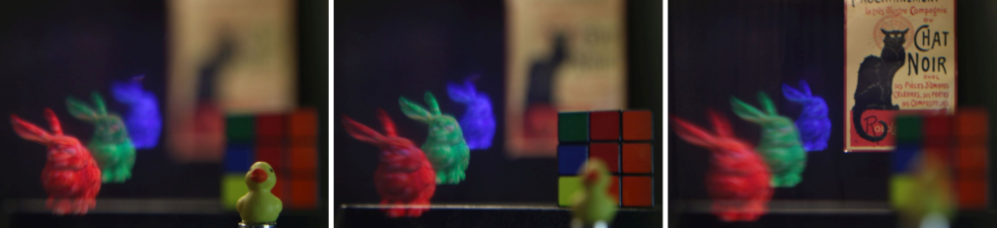
Rendering for Low-Latency Augmented Reality Light Field Displays
Henry Fuchs, Kishore Rathinavel, Hanpeng Wang, Alex Blate
UNC Chapel Hill
Intel 2019.04.24
This research was supported in part by NSF grant 1405847, by a research gift from Intel Corporation, and by the BeingTogether Center, a collaboration between Nanyang Technological University (NTU) Singapore and University of North Carolina (UNC) at Chapel Hill. Thanks also to Peter Lincoln, Andrei State, and Jim Mahaney for helpful discussions.
Notes:
Today, I shall talk to you about a our new approach to address one of the key limitation in current generation virtual reality and augmented reality displays.

Slide 2
Challenges for Light Field Displays
Cost increase by the number of angular views (~10x)
Computation: in GPU and Display Controller
Communication: GPU-to-Display
Display: Dividing native pixels among angular views
Opportunity: Incremental computations in GPU-to-Display pipeline and in Display Controller
Real World
Conventional Display
Light Field Display

Slide 3
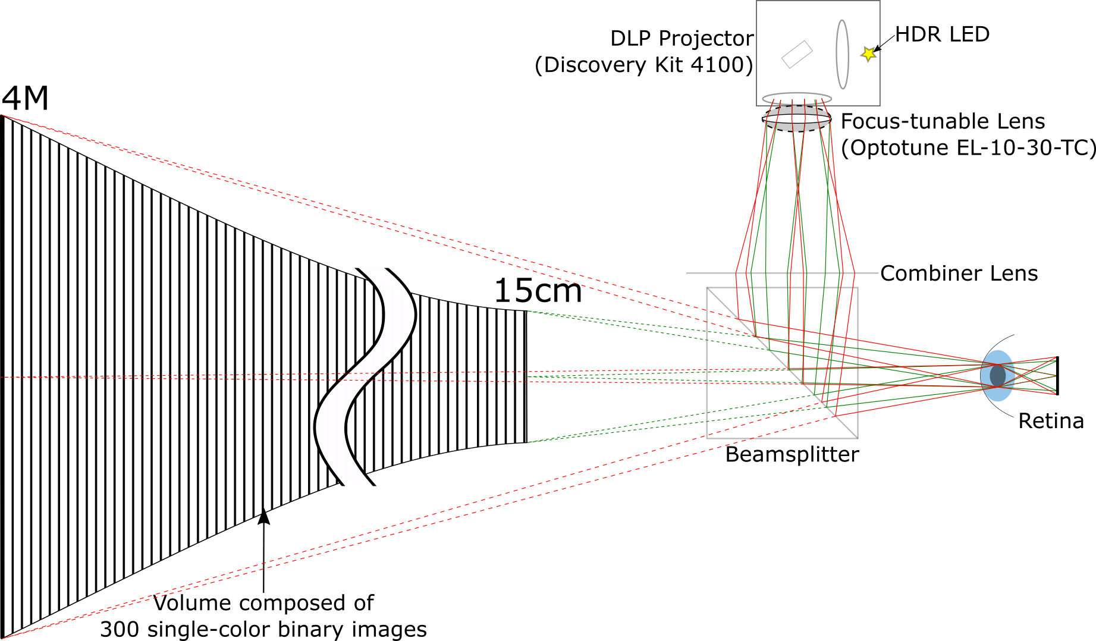
Display Overview: Micro-Mirrors (DLP) + Tunable Lens + HDR LEDs
Notes:
Our solution is to build a high-speed near-eye display that sweeps out a dense set of virtual images. Before diving into the details, let me just give you an idea of the dimensions of the volume.

Slide 4
Recent Work: Real-Time Rendering
PC: Interactive user input
GPU: Rendering & scan conversion
FPGA 1 (Vertex 7): Decoding, LED control, lens sync
FPGA 2 (Vertex 5): DMD (micromirrors) control

Slide 5

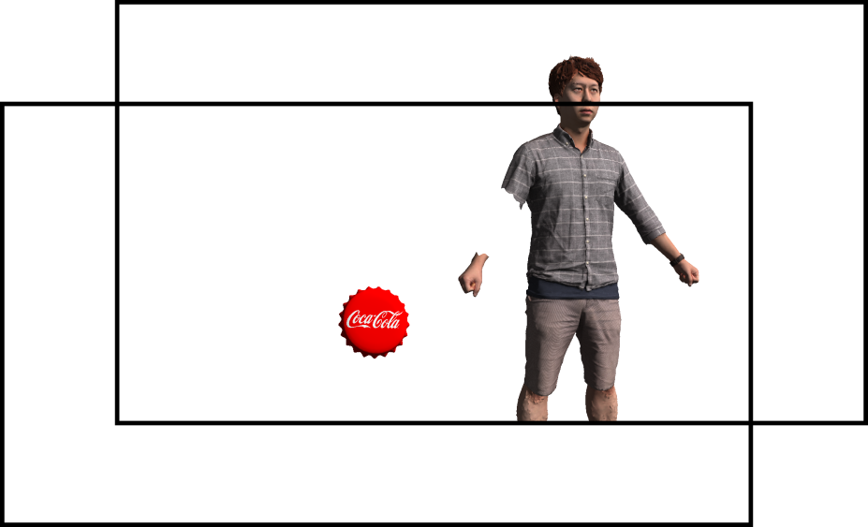
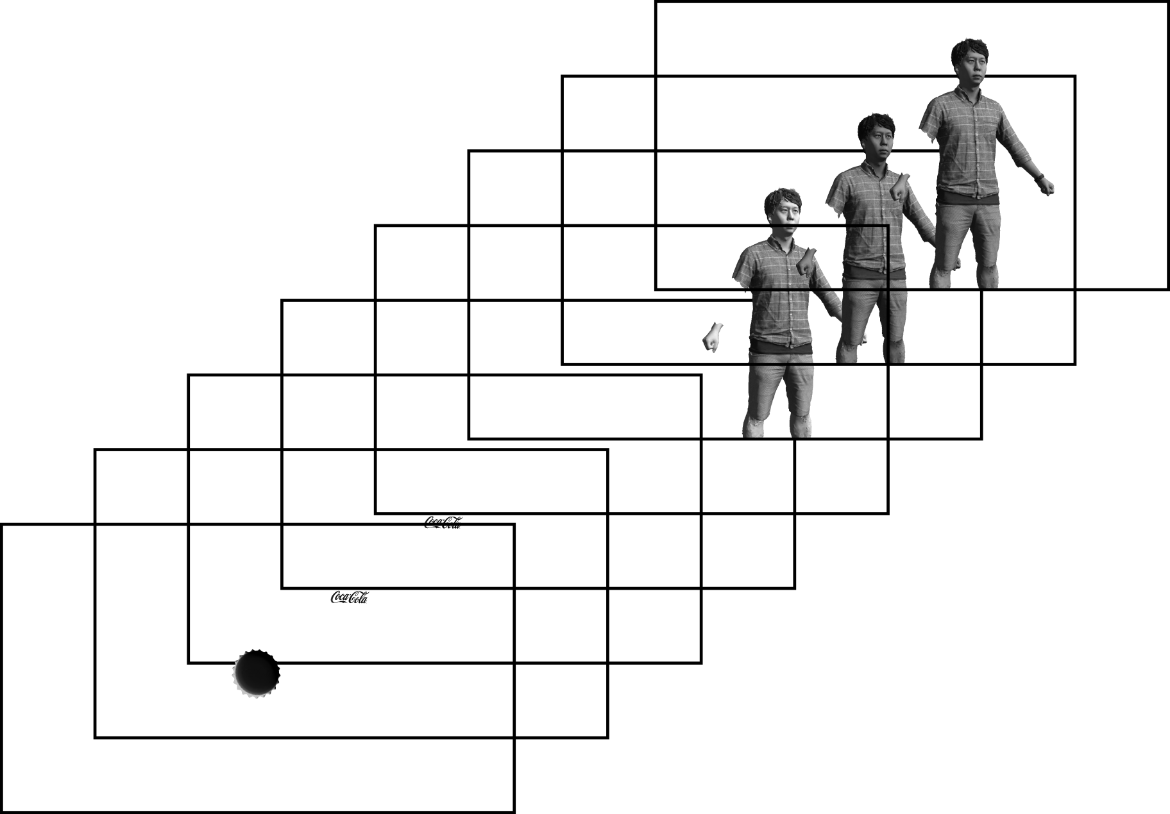
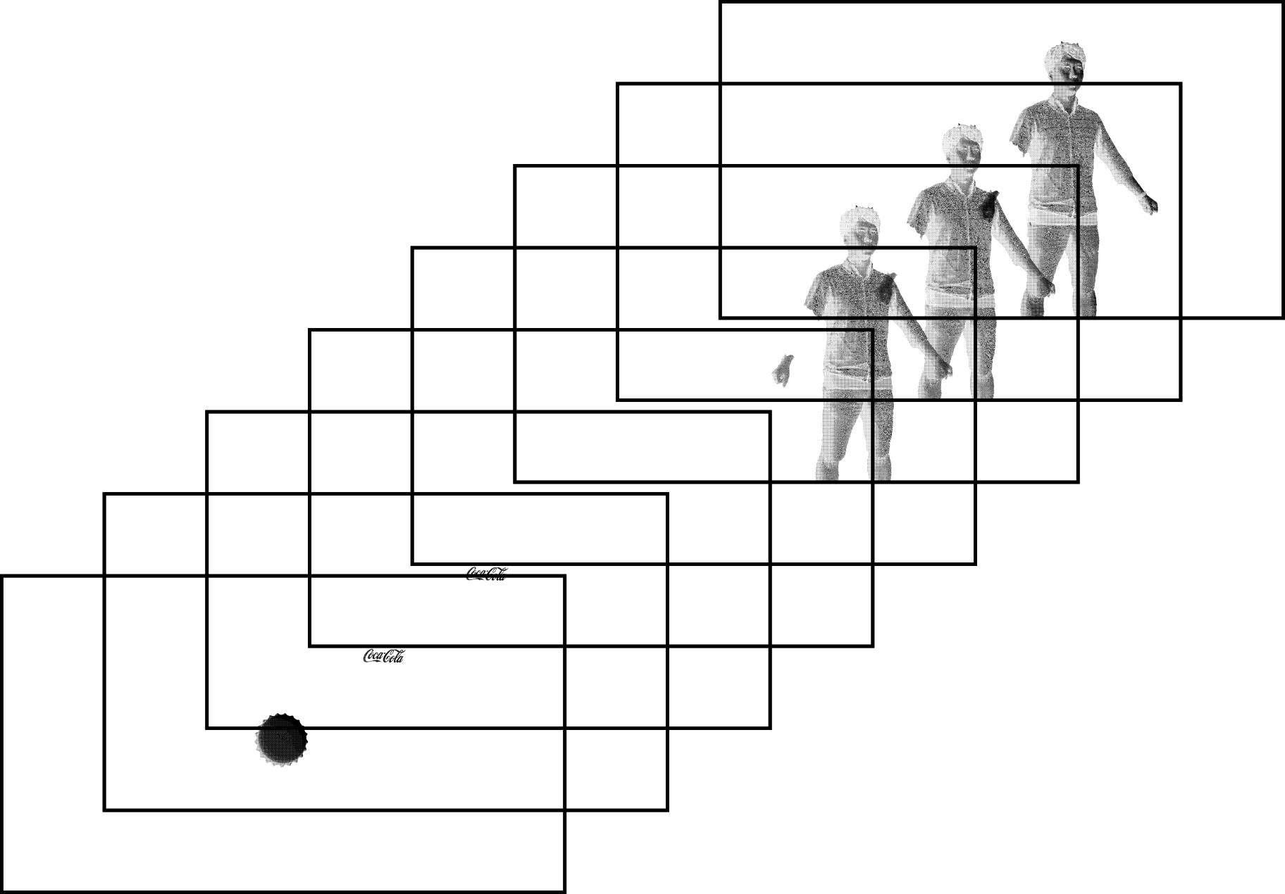

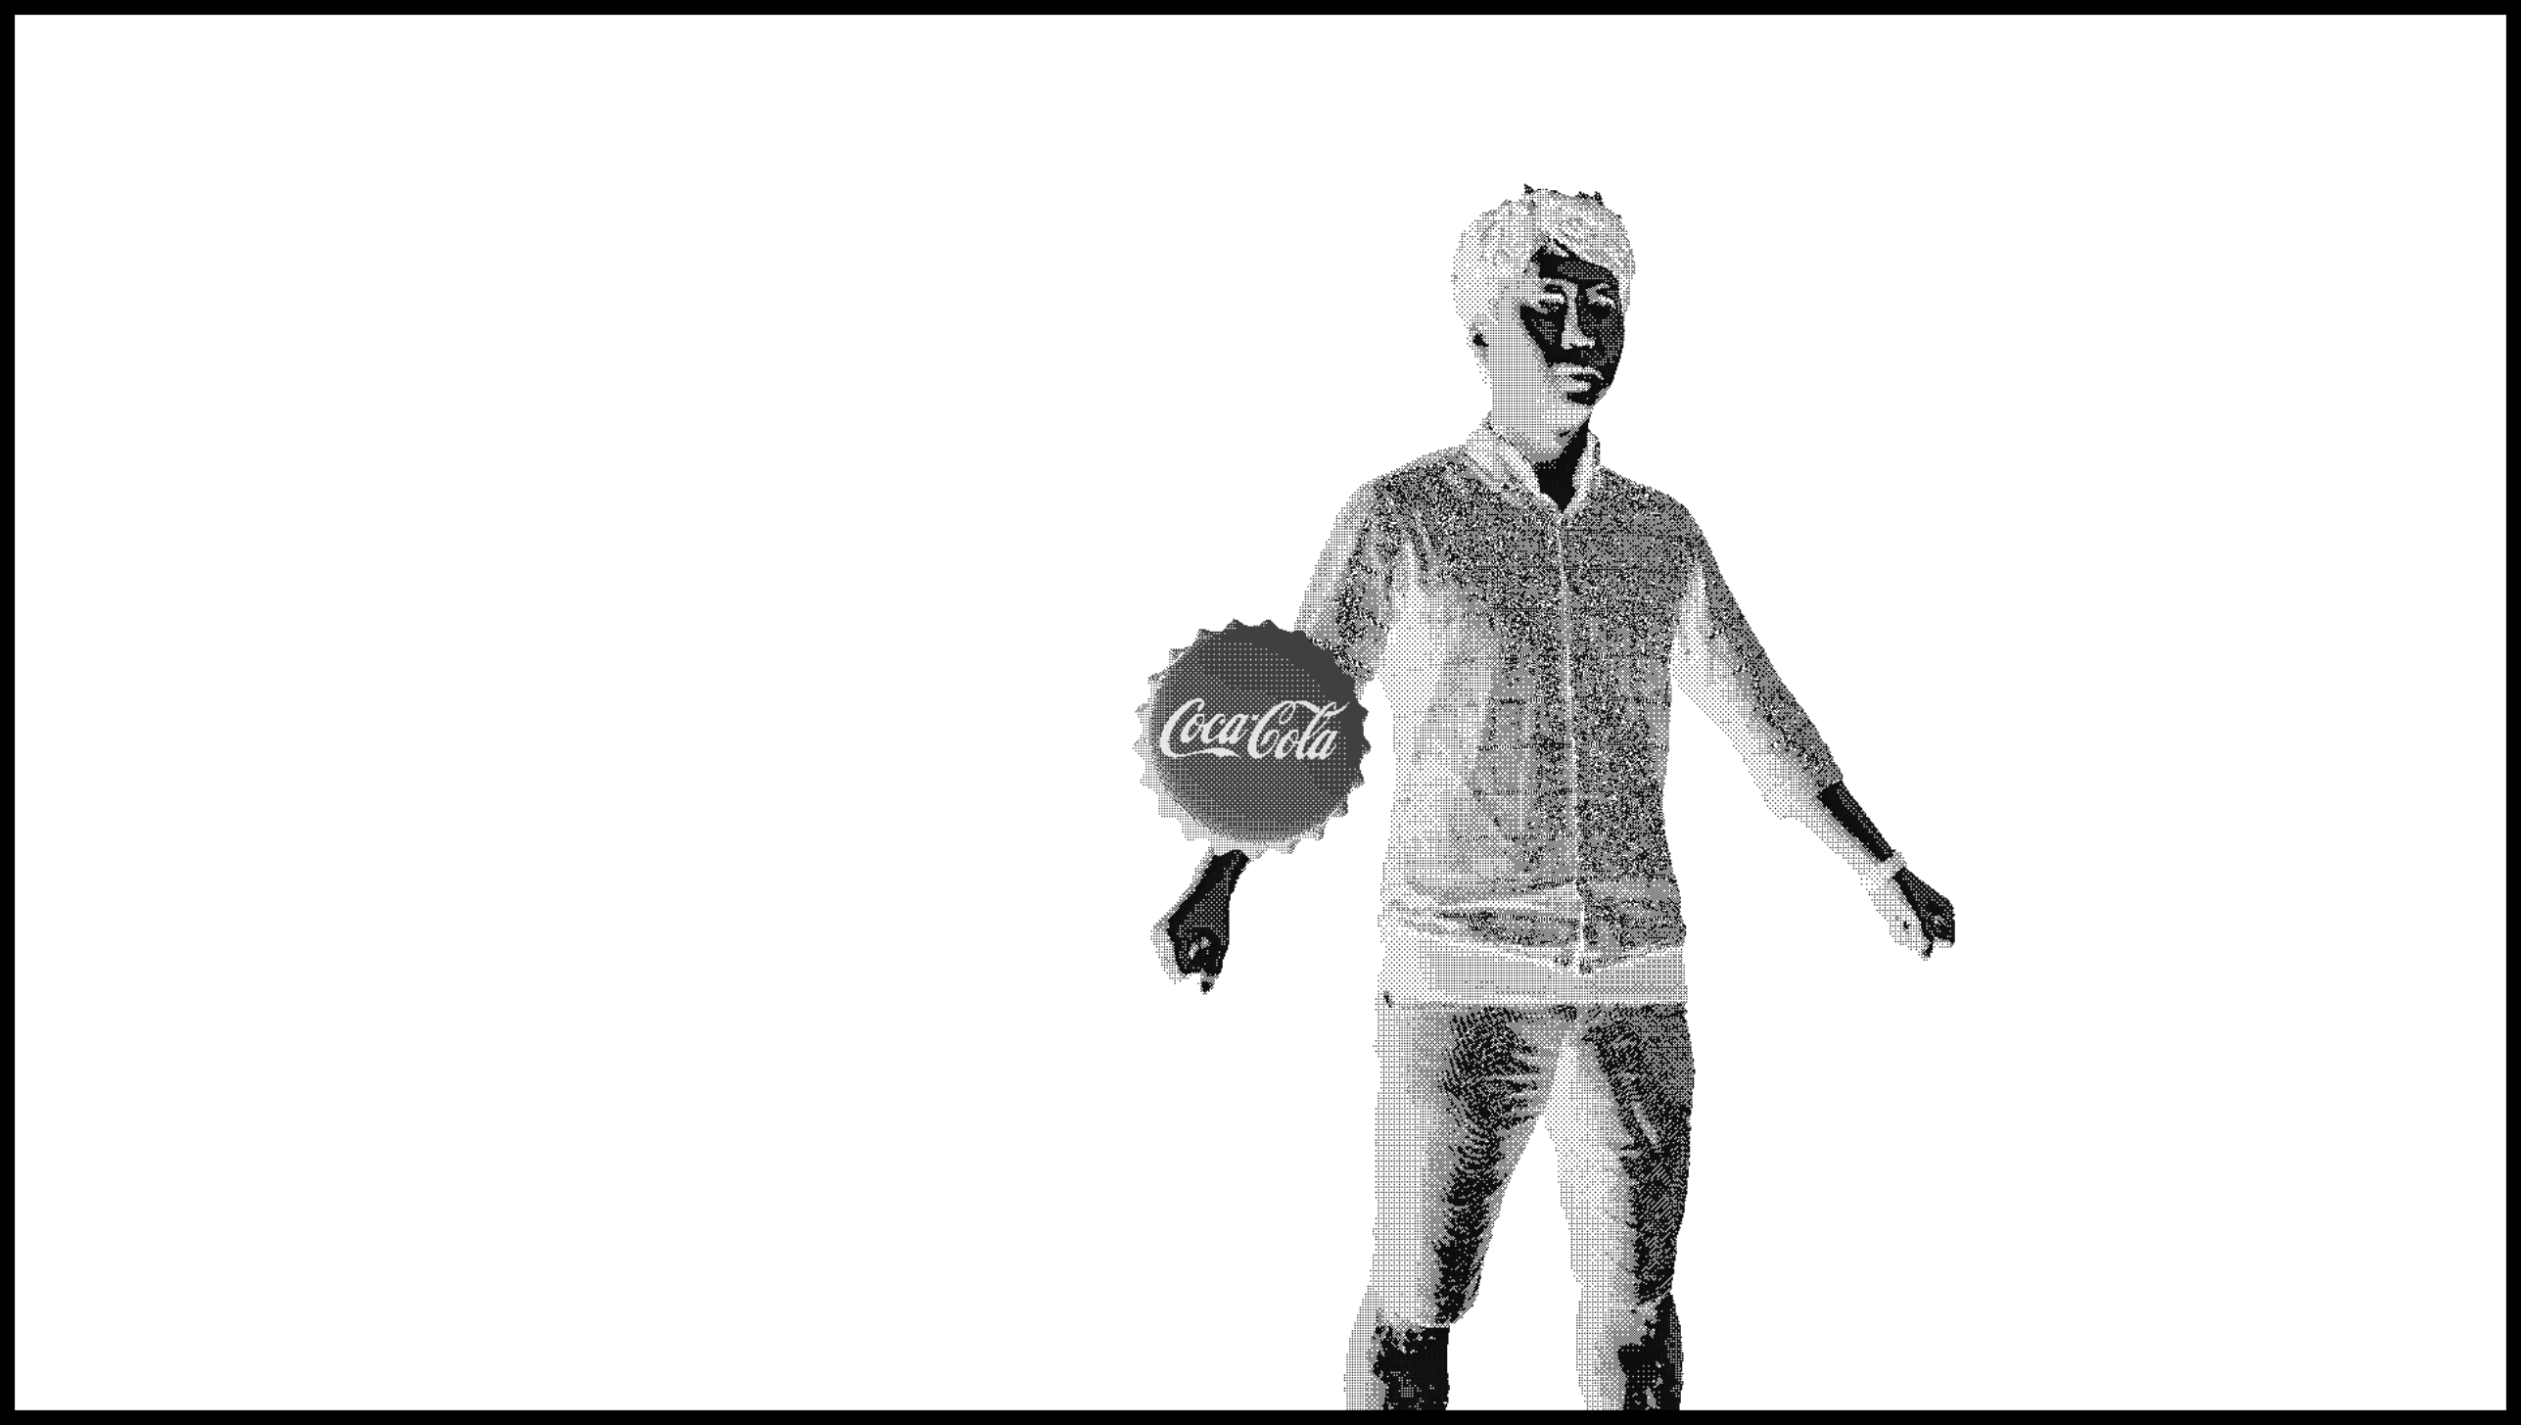
Current GPU Rendering Pipeline
Scene information
RGB image
Voxelization
Dithering
Color Image Slices
Color channels assigned
to different depth planes
Each dithered image
mapped to one bitplane
Depth map
Encoded image sent to display
Notes:
Now going from the color volume to the binary volume, our key idea is:
The color voxel can be represented by multiple binary voxels as long as the binary voxels are distributed along the perspective projection lines and the binary voxels are sufficiently close to the original color voxel's location. Binary voxels placed along any one of these lines will integrate to a single pixel on the retina.
There can be several decomposition schemes that implement our idea. Here, I'll tell you about a simple scheme.

Slide 6
Real-Time Rendering: FPGA Implementation
PC/GPU
DisplayPort 1.2
Frame Size: 1920х1080х24b
Frame Rate: 60HZ
Xilinx Virtex-7 FPGA on HTG-777 Board
Image Reader
Dual-Ported Memory
DisplayPort Decoder
Read Addresses
8 operation every 60Hz
Write Pixel Data
4 pixels per video clock
Read Pixel Data
128 pixels per 100MHz clock
Frame size: 1024х768х8b
Bitplane Selector & LED Controller
Synchronization Signal
Signal Frequency: 60Hz
Focus-tunable Lens
Binary Pixel Data
128 pixels per 100MHz clock
Frame size: 1024х768х1b
Maximum Link Frame Rate: 16kHz
Xilinx Virtex-5
FPGA on TI DLP Discovery Kit Board
DMD
Custom
High Speed LED/DAC Board
LED Controlling Data
3 channel: RGB
16bits for each color component

Slide 7
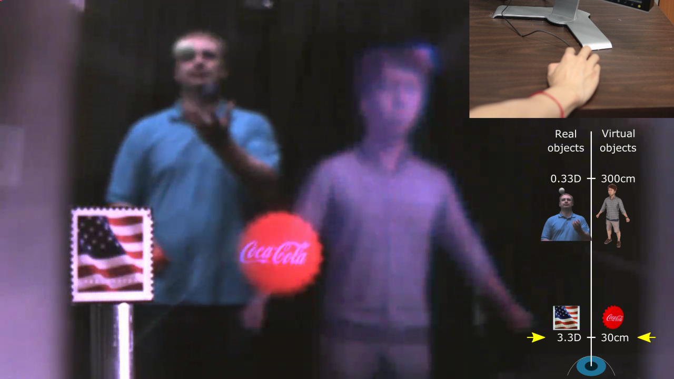

Slide 8
Future Work
Short term
Increase number of depth planes (8 to 280)
Optimize RGB color for each depth plane (not just single R,G, or B)
Post rendering warp
Distortion correction for post-rendering warp
Longer term
Transparency, photo-realistic rendering
Intra-pupillary occlusion:
Measure effect in our display. Possible solutions:
Eye tracking
Re-think decomposition

Slide 9
Key decision point
Where do we decompose color volume to binary images?
Compute all binary images on GPU and transmit (need 4x communication bandwidth that we have currently. Mainly limited by a custom board that we made)
Send RGB + depth maps and do the decomposition on the FPGA (needs more powerful FPGA with larger block RAM)

Slide 10
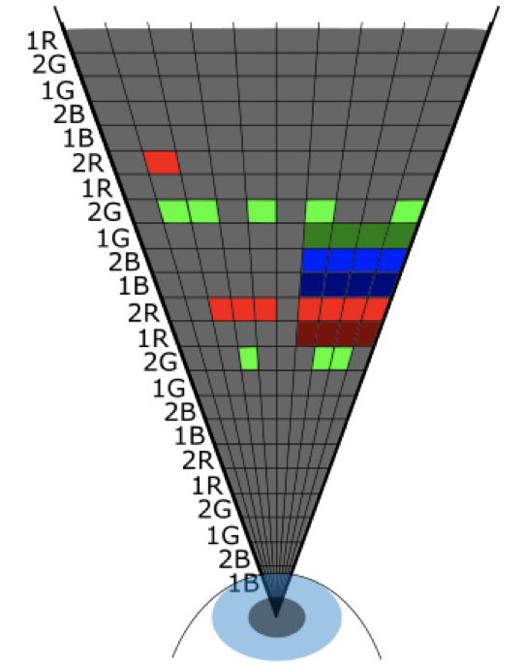
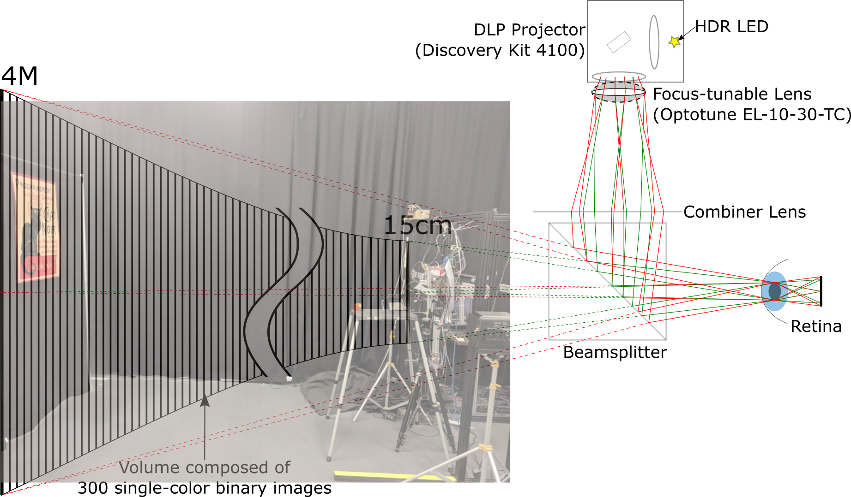
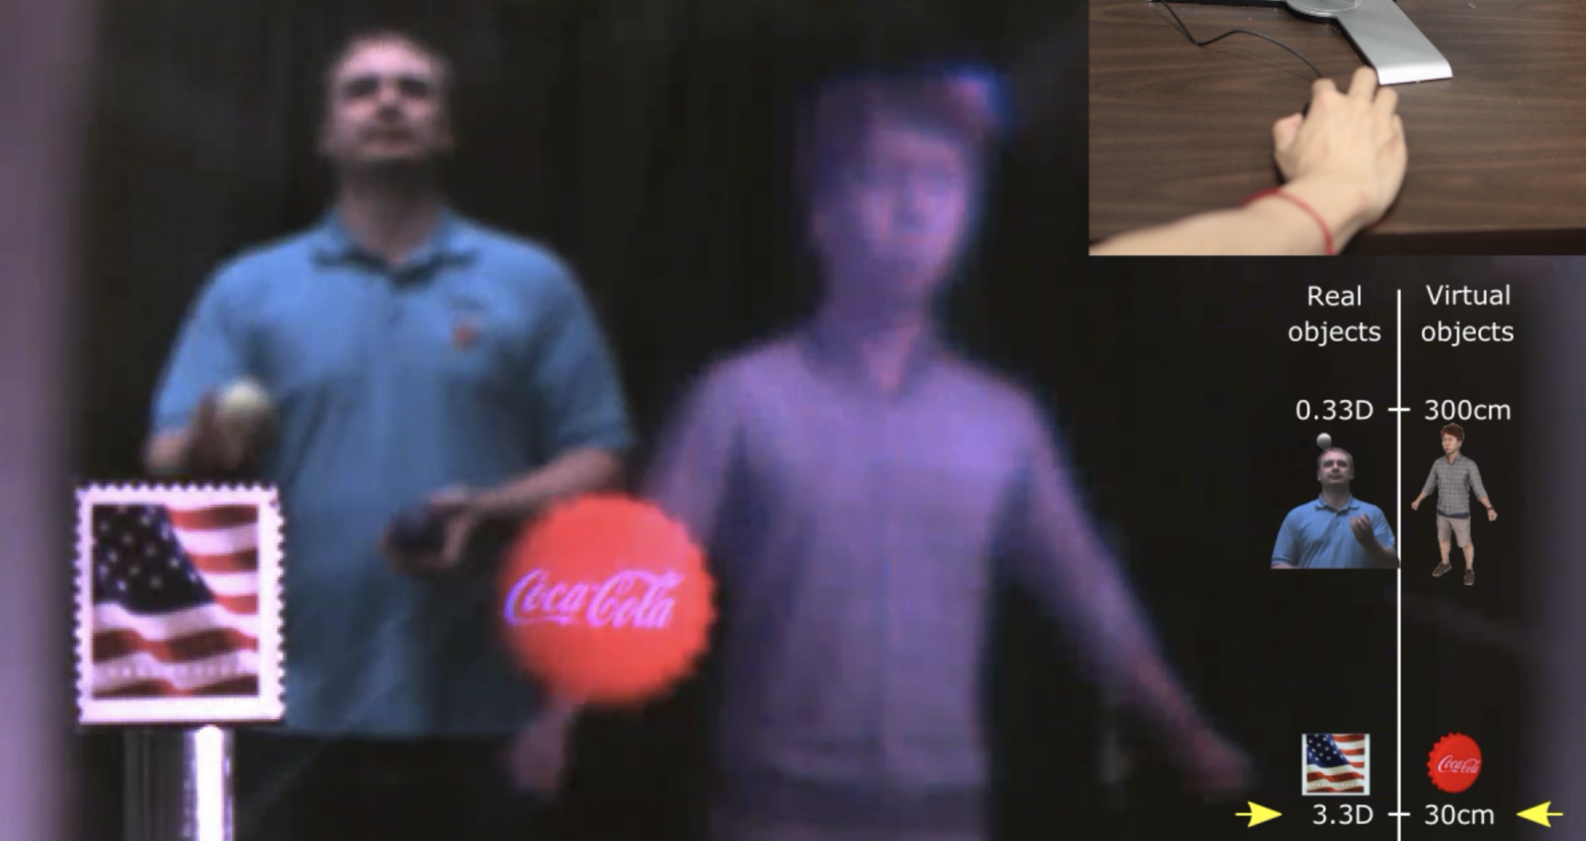
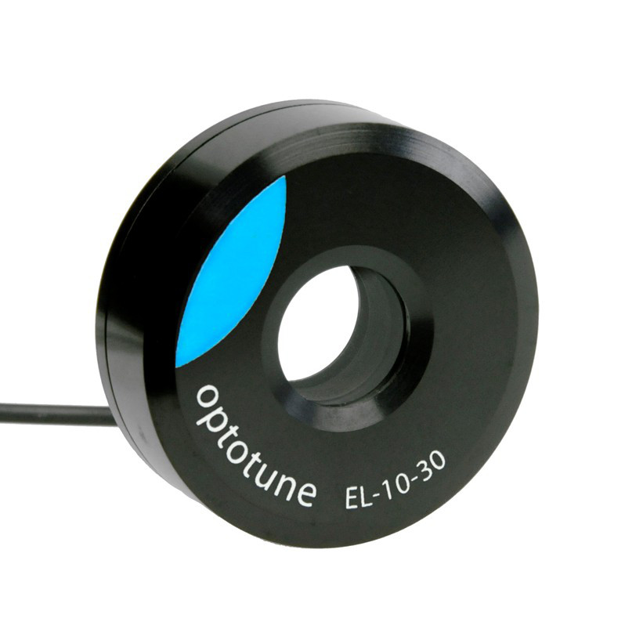
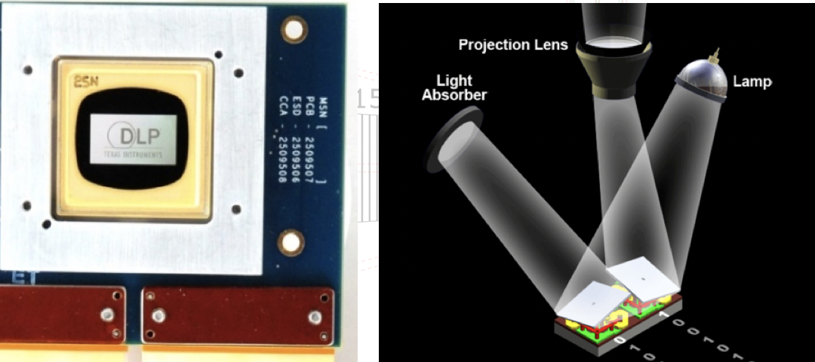
Thank You

